Slide 1


Micro-Credit Defaulter Model

Slide 2
PROBLEM statement
In a statement,The problem we will be exploring is binary classification (a sample can only be one of two things).This is because we're going to be using a number of differnet features (pieces of information) about a person to predict in terms of a probability for each loan transaction, whether the customer will be paying back the loaned amount within 5 days of insurance of loan. In this case, Label ‘1’ indicates that the loan has been payed i.e. Non- defaulter, while, Label ‘0’ indicates that the loan has not been payed i.e. defaulter.
Points to Remember:
• There are no null values in the dataset.
• There may be some customers with no loan history.
• The dataset is imbalanced. Label ‘1’ has approximately 87.5% records, while, label ‘0’ has approximately 12.5% records.
• For some features, there may be values which might not be realistic. You may have to observe them and treat them with a suitable explanation.
• You might come across outliers in some features which you need to handle as per your understanding. Keep in mind that data is expensive and we cannot lose more than 7-8% of the data.

Slide 3
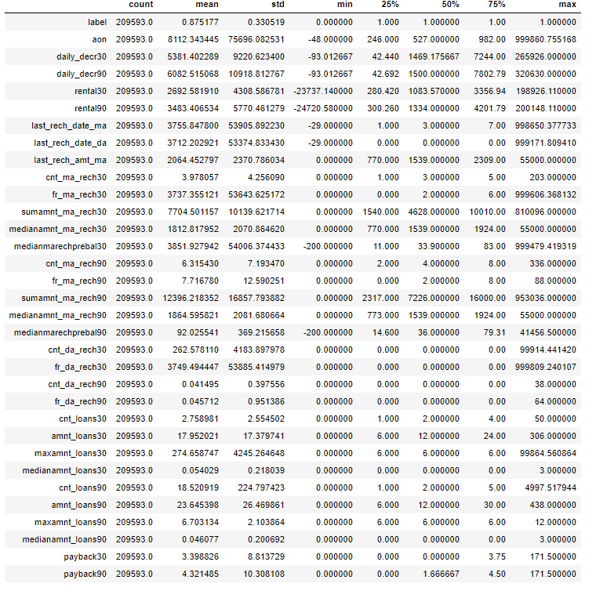
Analytical Problem Framing
From the above statistical summary of the above part of the dataset, we can see that the min value is negative which is not even possible for most of the features like daily recharge and main account balance, and last recharge can't be negative.
We created multiple group based on min, 25% to 75%, above 75% and we compared it VS payback within 5 days.
We identified the outliers for features whose Z-score>3, and then did mean imputing and also applied cube root to bring the data closer to distribution.
We checked the correlation of the independent and dependent features and dropped the negative and less important features with the help of correlation matrix.

Slide 4
Data Pre-processing Done
We checked the correlation of the independent and dependent features and dropped the negative and less important features with the help of correlation matrix.
There were data for 30 and 90 days, so considering data for 90 days is adding more information rather than then data of 30 days.
Some features can’t have any negative value, so those features were treated accordingly.
Outliers are treated manually for the features giving some important information, and then the threshold values were set to make the data freee from outliers.
Data lost is very less i.e less than the 7% which was stated in the documentation.
Applied SMOTETomek, to balance the dataset as the dataset was imbalanced dataset.
Applied StandardScaler to our dependent features.
Applied various machine learning model and compared it.
Applied hyper tunning several models, but couldn’t achieve much better results.
Saving final predictions in file.csv format

Slide 5
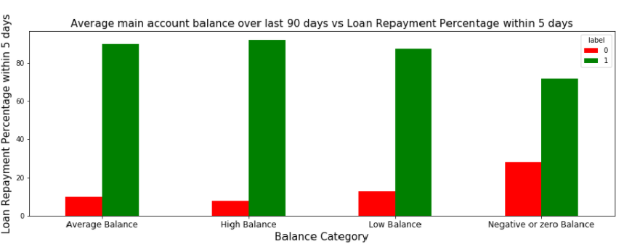
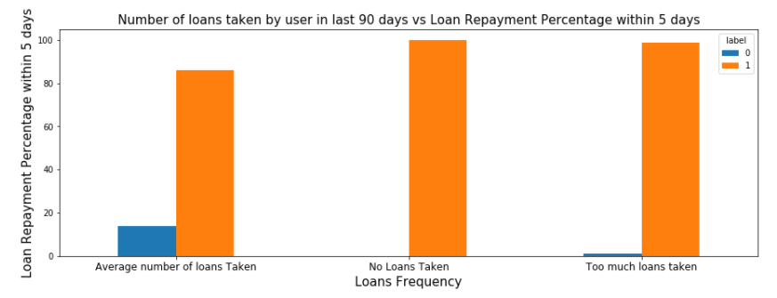
Data Inputs- Logic- Output Relationships
1) 28% of Users having negative or zero balance are defaulters, which is very high.
2) 10% to 12% Users are defaulters which falls in the category of Average and Low balancecategory.
3) Users having high balance and are defaulters are very less in number
1) Users who take more number of loans are non-defaulters (i.e. 98% of the category) as they repays the loan within the given time i.e. 5 days.
2) 14% of the Users are are among the average number of loan taken category are defaulters.

Slide 6
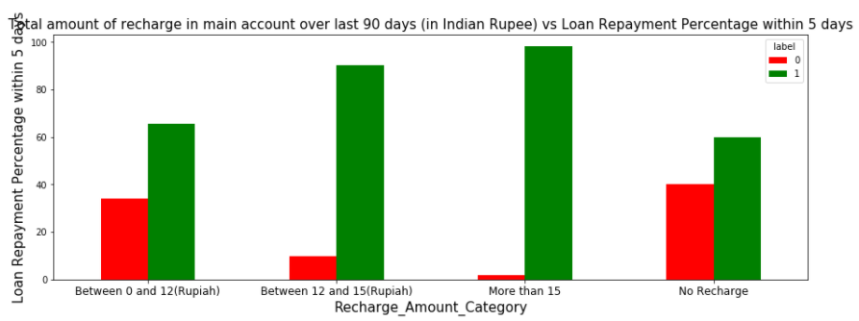
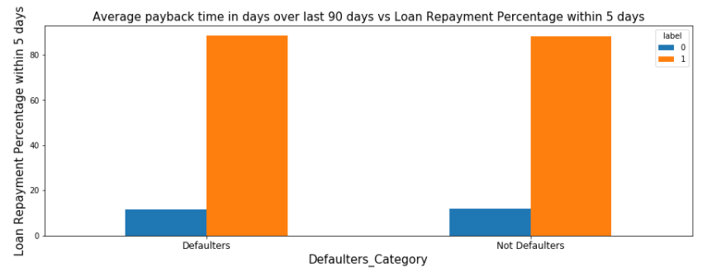
1) 40 % of the Users who do not even recharged in the 90 days are defaulters only.
2) Users who do very high amount of recharge always pays their loans on time. i.e 98% of them are non-defaulters.
3) 34% of the Users who do less amount of recharge are defaulters.

Slide 7
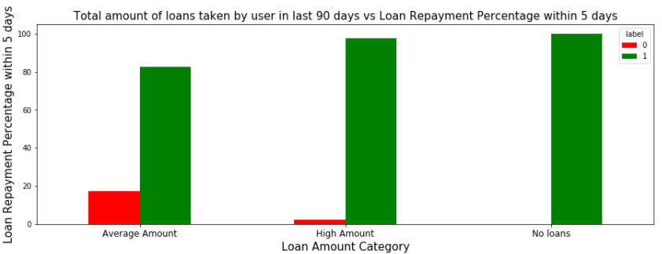
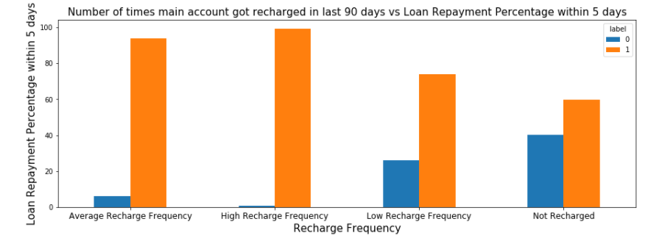
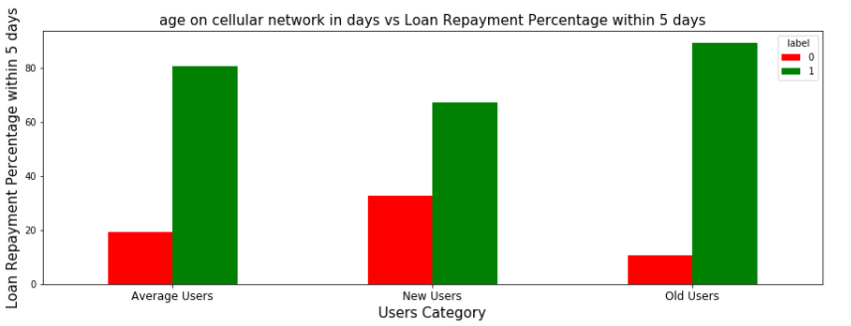
1) Users who did not take any loans are non-defaulters.
2) Most of the Users (i.e. 97%) who take large amount of loans comes under non defaulter category.
3) 17% of the users who take small loans are defaulters.
1) Among the Users who have not done a single recharge in 3 months 40% are defaulters.
2) Among the Users who are very frequent in recharging and who always pay their loans on time are more in number i.e 99% of the total category, which is a good news for the company.
1) 32% of the users who are defaulters are the new users.
2) Old Users are trusted and they are mostly non defaulters.

Slide 8
Model/s Development and Evaluation
Identification of possible problem-solving methods
As we seen the dataset is imbalanced i.e
Label ‘1’ has approximately 88.3% records, while, label ‘0’ has approximately 11.6% records.
So to make dataset balanced applied SMOTETomek.

Slide 9
Testing of Identified Approaches (Algorithms)
RandomForestClassifier
GradientBoostingClassifier
LogisticRegression
AdaBoostClassifier
ExtraTreesClassifier
XGBClassifier

Slide 10
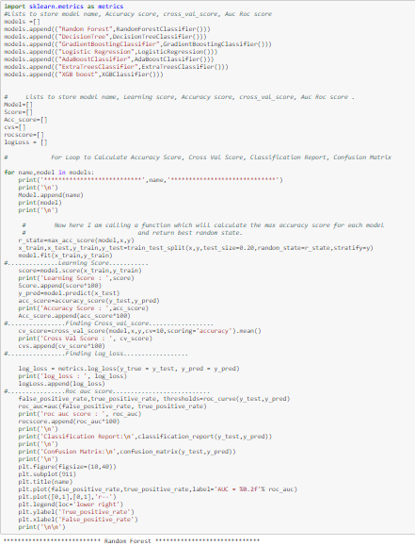
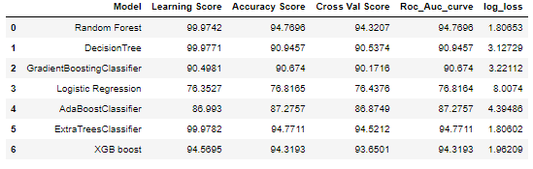
Run and Evaluate selected models
Key Metrics for success in solving problem under consideration

Slide 11
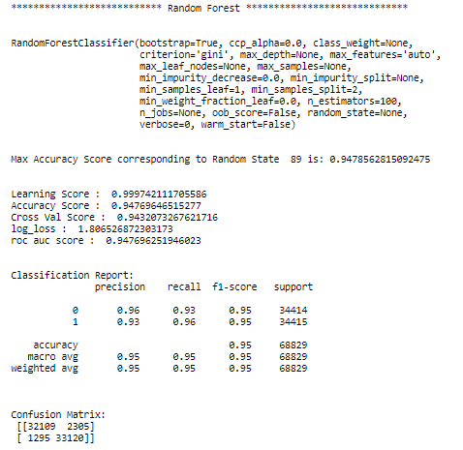
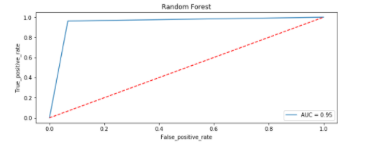
VISUALIZATIONS
Random Forest

Slide 12
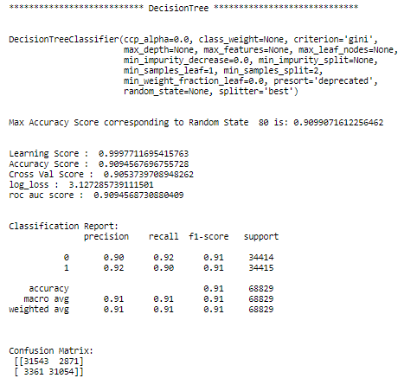
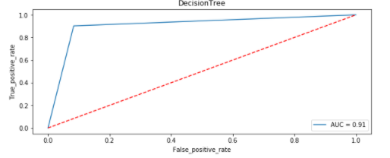
Decision Tree

Slide 13
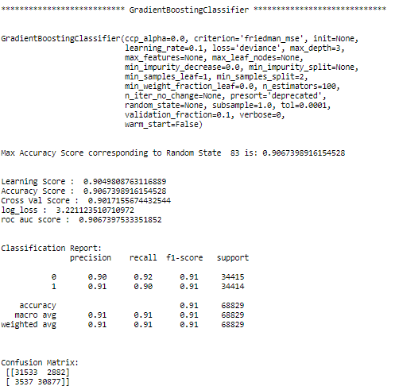
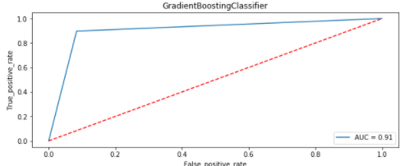
Gradient Boosting Classifier

Slide 14
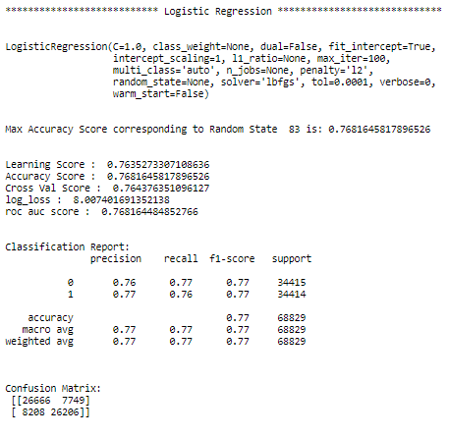
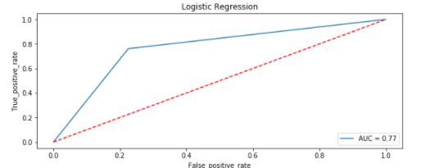
Logistic Regression

Slide 15
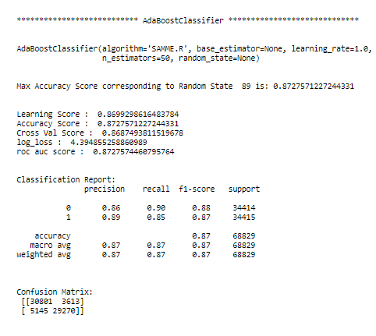
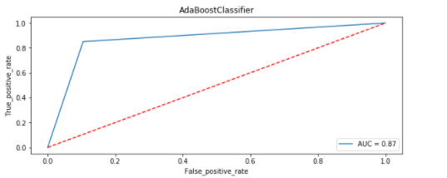
Adaboost Classifier

Slide 16
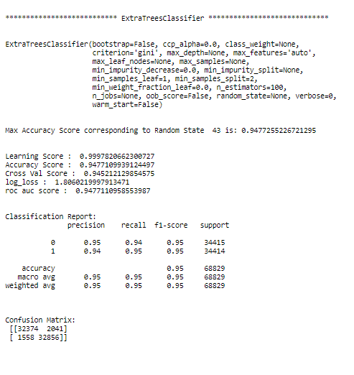
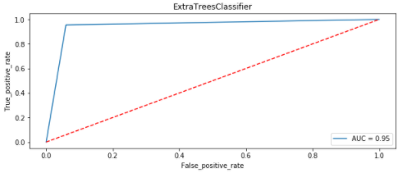
Extra TreesClassifier

Slide 17
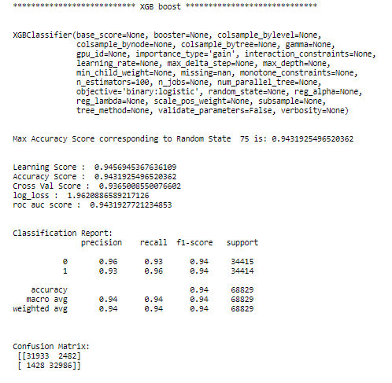
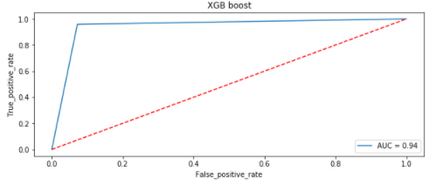
XGB Boost Classifier

Slide 18
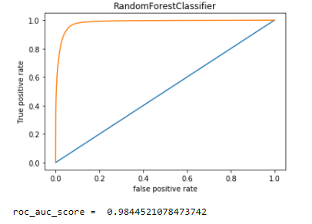
Finalize the model
From the above visualization and matrices found that the RandomForest Classifier performed the best 98% AOC_ROC_SCORE, with precision recall score of 95%, however the max score which we were able to achieve from dataset provided.

Slide 19
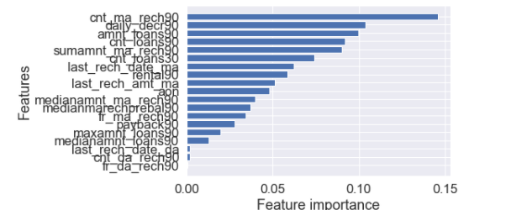
FEATURE iMPORTANCE
Cnt_ma_rech90 is contribute the most as compared to other features

Slide 20
CONCLUSION
1) 28% of Users having negative or zero balance are defaulters, which is very high.
2) 10% to 12% Users are defaulters which falls in the category of Average and Low balancecategory.
3) Users having high balance and are defaulters are very less in number
4) Users who take more number of loans are non-defaulters (i.e. 98% of the category) as they repays the loan within the given time i.e. 5 days.
5) 14% of the Users are are among the average number of loan taken category are defaulters.
6) 40 % of the Users who do not even recharged in the 90 days are defaulters only.
7) Users who do very high amount of recharge always pays their loans on time. i.e 98% of them are non-defaulters.
8) 34% of the Users who do less amount of recharge are defaulters.
9) Users who did not take any loans are non-defaulters.
10) Most of the Users (i.e. 97%) who take large amount of loans comes under non defaulter category.
11) 17% of the users who take small loans are defaulters.
12) Among the Users who have not done a single recharge in 3 months 40% are defaulters.
13) Among the Users who are very frequent in recharging and who always pay their loans on time are more in number i.e 99% of the total category, which is a good news for the company.
14) 32% of the users who are defaulters are the new users.
15) Old Users are trusted and they are mostly non defaulters.
16)Random forest performs the best as compared to others models with high f1 score of 95% and roc_auc score 98% .
17)Cnt_ma_rech90 is contribute the most as compared to other features

